Slide 1
The role of the airway epithelium in asthma

Slide 2
Asthma is driven by interactions between the environment, epithelium and immune system^{1–6}
Environmental exposures^{1,2}
Epithelium^{2–4}
Immune system^{5,6}
Key role in tissue homeostasis
Mediator between environment and immune system
Rapid production of epithelial cytokines in response to exposures
Allergic eosinophilic inflammation
Non-allergic eosinophilic inflammation
Non-T2 (non-eosinophilic) mechanisms
Structural cell changes
Viruses
Allergens
Pollutants /smoke
Bacteria
Physical injury
Other external stimuli (eg house dust mites)
T2, type 2 1. Pelaia G, et al. Nat Rev Drug Discov 2012;11:958–972; 2. Bartemes KR, Kita H. Clin Immunol 2012;143:222–235; 3. Watson B, Gauvreau GM. Expert Opin Ther Targets 2014;18:771–785; 4. Loxham M, et al. Clin Exp Allergy 2014;44:1299–1313; 5. Brusselle G, Bracke K. Ann Am Thorac Soc 2014;11(Suppl. 5):S322–S328; 6. Gauvreau GM, et al. Expert Opin Ther Targets 2020;24:777–792

Slide 3
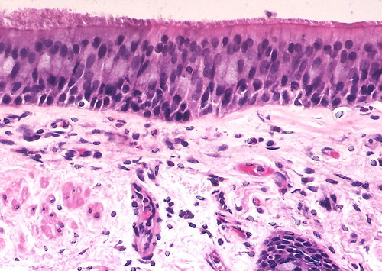
The airway epithelium is a first point of contact for environmental exposures¹
Barrier and sensor
Protective barrier and sensor of the environment^{1,2}
Mediates
immunity
Innate and adaptive immune response²
Induces inflammation
Epithelial cytokines promote airway inflammation^{1,2}
Structural changes
Can drive airway remodelling and smooth muscle pathology^{1,3,4}
Image of normal lung; bronchus by Yale Rosen, available at https://www.flickr.com/photos/pulmonary_pathology/3661529896 (Accessed 6 January 2022) Licensed under CC BY-SA 2.0 from: https://creativecommons.org/licenses/by-sa/2.0/ (Accessed 6 January 2022) 1. Bartemes KR, Kita H. Clin Immunol 2012;143:222–235; 2. Roan F, et al. J Clin Invest 2019;129:1441–1451; 3. Wang Y, et al. Respir Med 2008;102:949–955; 4. Corren J. J Allergy Clin Immunol Pract 2019;7:1394–1403

Slide 4
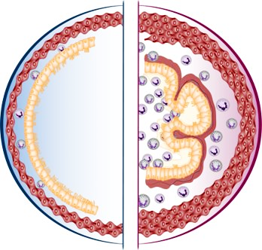
The airway epithelium plays a fundamental role in asthma^{1–4}
Healthy airway
Severe asthma
Goblet cell hyperplasia and ↑ mucus production^{1,3}
Leads to airway blockage
The airway epithelium serves as a barrier/sensor and mediates airway immunity^{1,2}
In severe asthma, the epithelium is significantly altered^{1–4}
↓ Epithelial tight-junction number and integrity^{3,4}
Tissue damage as external insults penetrate the airway wall
↑ Basal membrane thickness^{1,3,5}
Increased matrix deposition→ airway narrowing
Sub-epithelial inflammation and fibrosis⁵
Can lead to fixed airway obstruction
Figure adapted from the Centre of Excellence in Severe Asthma as part of the Centre of Research Excellence in Severe Asthma (https://toolkit.severeasthma.org.au) (Accessed 6 January 2022) . 1. Bartemes KR, Kita H. Clin Immunol 2012;143:222–235; 2. Roan F, et al. J Clin Invest 2019;129:1441–1451; 3. Holgate ST. Immunol Rev 2011;242:205–219; 4. Heijink IH, et al. Clin Exp Allergy 2014;44:620–630; 5. Cohen L, et al. Am J Respir Crit Care Med 2007;176:138–145

Slide 5
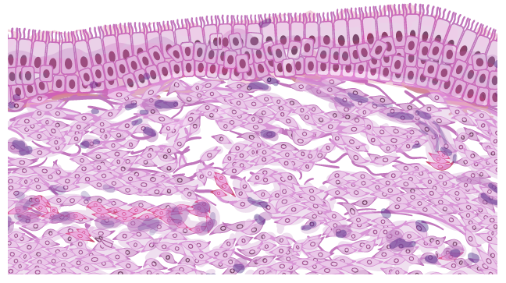
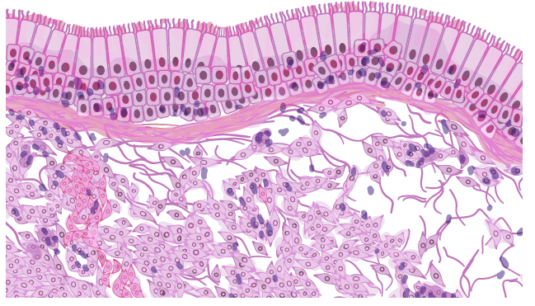
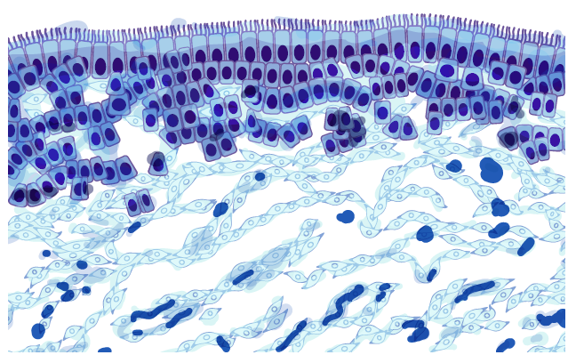
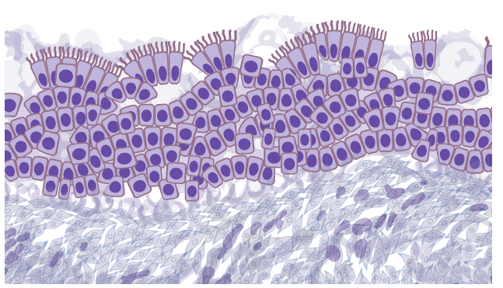
The airway epithelium structure is significantly altered in severe asthma^{1–5}
In bronchial biopsies of patients with severe asthma versus healthy controls:⁵
↑ Epithelial thickness versus normal airway (A)
↑ Epithelial cell proliferation versus normal airway (B)
↑ Apoptosis versus normal airway
Normal airway
Severe asthma
Epithelial thickness (mean ± SD):
28±10 mm
37±14 mm
A Haematoxylin- eosin staining
B Staining of cellular
proliferation
marker
Epithelial cells stained (mean ± SEM):
61±32 cells/mm²
386±116 cells/mm²
Figure adapted from Cohen L, et al. Am J Respir Crit Care Med 2007;176:138–145 SD, standard deviation; SEM, standard error of the mean 1. Bartemes KR, Kita H. Clin Immunol 2012;143:222–235; 2. Holgate ST. Immunol Rev 2011;242:205–219; 3. Heijink IH, et al. Clin Exp Allergy 2014;44:620–630; 4. Caminati M, et al. World Allergy Organ J 2018;11:13; 5. Cohen L, et al. Am J Respir Crit Care Med 2007;176:138–145

Slide 6
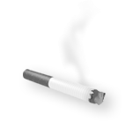
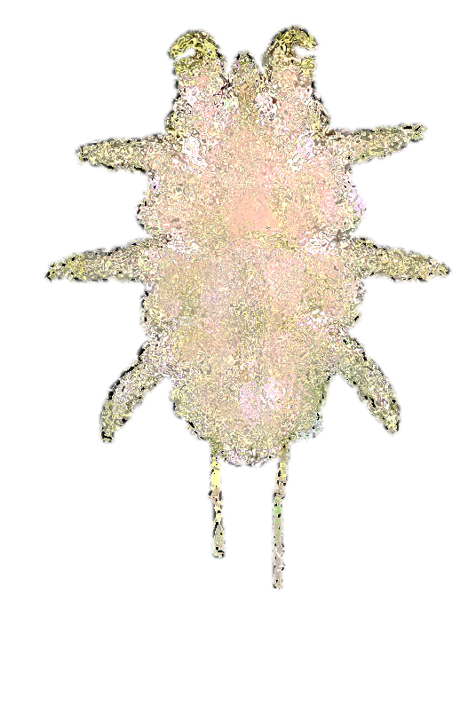
Environmental exposures trigger airway inflammation at the epithelium^{1–4}
Pathogens
Aeroallergens
Air pollutants
Respiratory viruses and bacteria^{1,2}
Dust mites, cockroaches, animal dander, moulds, pollen³
Smoke, dust, chemical pollution, particulate matter⁴
1. Wark PA, Gibson PG. Thorax 2006;61:909–915; 2. Iikura M, et al. PLoS One 2015;10:e0123584; 3. Baxi SN, Phipatanakul W. Adolesc Med State Art Rev 2010;21:57–71; 4. Lambrecht BN, et al. Immunity 2019;50:975–991

Slide 7
The triggers of asthma are diverse¹
Self-reported asthma triggers (N=1202)
Proportion of participants who experienced an allergic trigger
Proportion of participants who experienced a non-allergic trigger
Frequency of trigger
Frequency of triggers (weeks/year)
Proportion of participants who experienced the trigger (%)
Figure adapted from Price D, et al. J Asthma. 2014;51:127–135 (http://creativecommons.org/licenses/by/3.0) (Accessed 6 January 2022). 1. Price D, et al. J Asthma 2014;51:127–135

